Slide 1
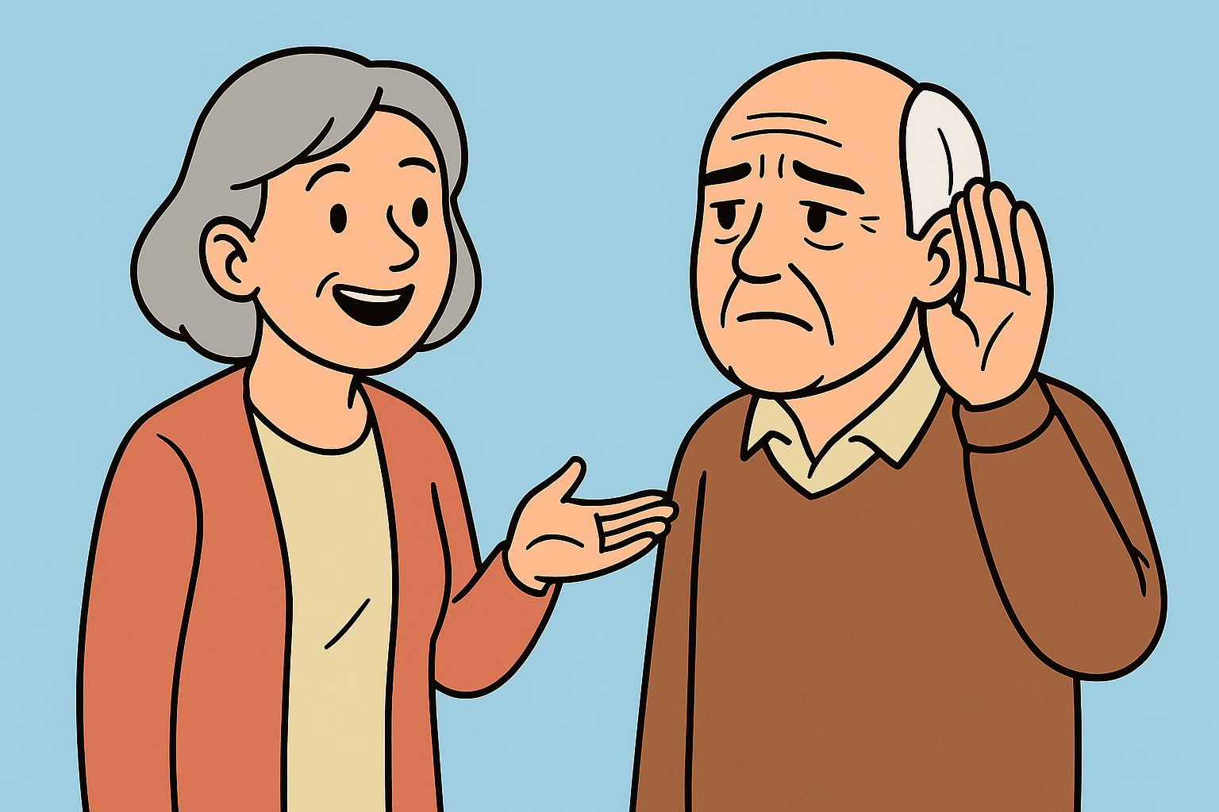
Hearing Your Best
What’s Normal
What’s Not
What You Can Do

Slide 2
Topics
Prevalence of hearing loss
Causes of hearing loss
Signs and symptoms of hearing loss
Treatment Options
Hearing loss and Dementia

Slide 3
How common is hearing loss?
One of eight people in the United States (~30 million) aged 12 years and older has hearing loss in both ears.
Age is the strongest factor when it comes to hearing loss.
Percentages by age group:
2% of adults between 45 – 54 years
8.5% of adults between 55 – 64 years
25% of adults between 65 – 74 years
50% of adults 75 years and older

Slide 4
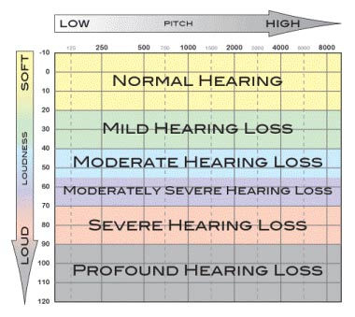
What’s “normal” hearing loss?
Type of Hearing Loss
Degree of Hearing Loss
Configuration of Hearing Loss

Slide 5
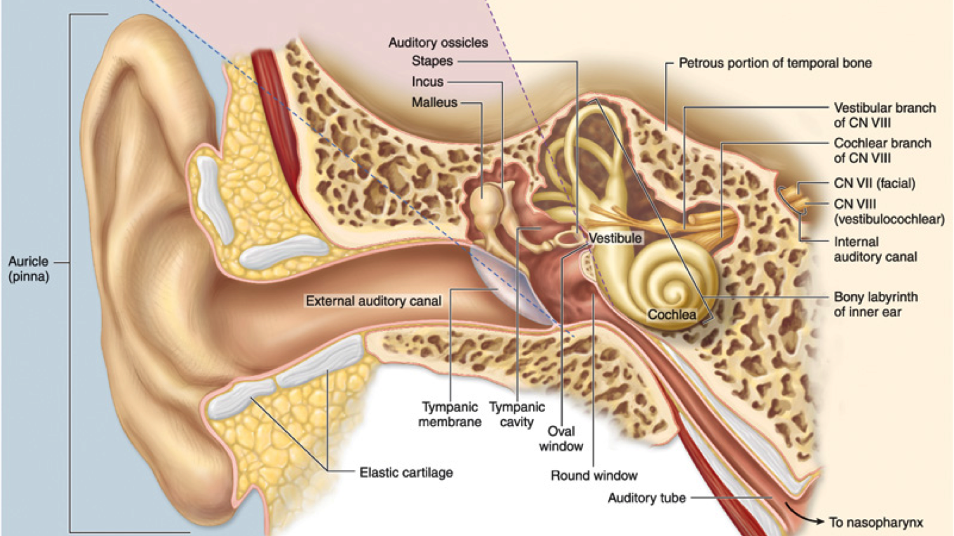
Parts of the Ear

Slide 6
Causes of Hearing Loss
Depends on the type of hearing loss and where in the ear the problem is located.
Aging
Noise exposure
Heredity
Infections
Trauma
Impacted wax in ear canal(s)
Hardening/stiffening of middle ear bones

Slide 7
Are you hearing your best? A Quick Self-Check
I hear people talking, but I’m not always sure what they said.
I ask others to repeat themselves more than I used to.
Conversations are harder to follow in restaurants or groups.
I hear better when I can see the speaker’s face.
The TV or radio volume seems louder to others than it does to me.
People sometimes sound like they’re mumbling.
I feel more tired or frustrated after long conversations.
I avoid certain social situations because listening feels like work.

Slide 8
So, I think I might have a hearing loss…now what?
Speak to your physician
Schedule a hearing evaluation appointment with an audiologist
Case history
Otoscopy
Pure tone testing
Speech testing
Other testing, as needed
Explain results
Provide recommendations

Slide 9
Treatment Options for Hearing Loss
Hearing Aids
Cochlear Implants
BAHAs
Aural Rehabilitation

Slide 10
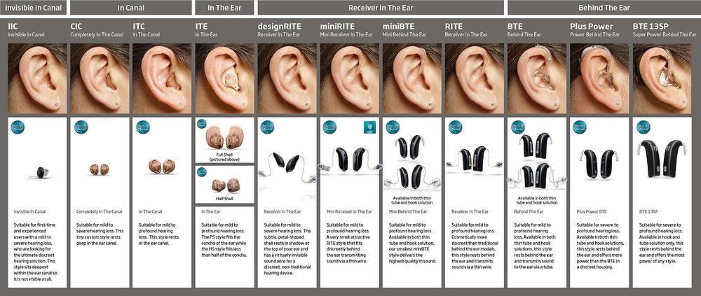
Hearing Aid Styles
Behind the Ear
In the Ear
In the Canal
Completely in the Canal

Slide 11
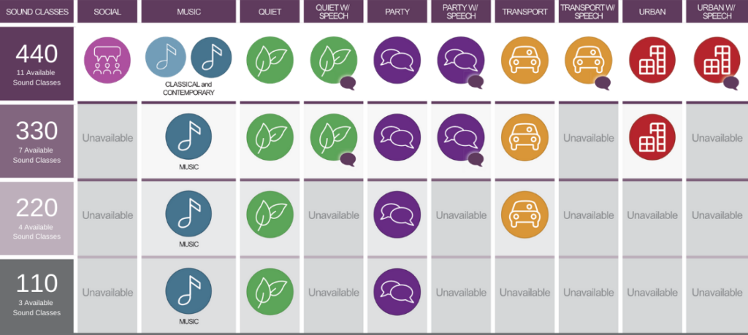
Hearing Aid Technology
Premium (~$2800-3000/device)
Advanced (~$2000-2200/device)
Basic (~$1300-1500/device)
Essenstial (~$800-1000/device)

Slide 12
Hearing Loss and Dementia
Studies are showing a relationship between hearing loss and cognitive decline.
Older adults who have hearing loss show higher rates of cognitive decline and dementia.

Slide 13

Questions?

Slide 14
Hearing Your Best
Part 2: Recap
Best Practices
Communication Strategies

Slide 15
Recap
Insurance Benefits
Audiology Services | Insurance Coverage | Physician Order Needed
Diagnostic hearing evaluations | Yes / All payers | Yes for Medicare No for Commercial Plans (but may be recommended
Hearing Aids and services | Medicare: No Medicare Advantage: Maybe* Commercial Plans: Maybe* | Usually no
* Could be covered by medical plan or third party administrator

Slide 16
Best Practices in Hearing Aid Fitting
Full comprehensive evaluation, including speech perception
Referring for medical clearance, if any of the following present:
History of active drainage from the ear in the previous 90 days
History of sudden or rapidly progressive hearing loss within the previous 90 days
Any acute or chronic dizziness
Any pain or discomfort in or about the ear
Visible congenital or traumatic deformity of the ear
Visible evidence of significant wax accumulation/foreign body in the ear canal
Unilateral hearing loss or significant asymmetrical hearing loss
Signs of conductive or mixed hearing loss in either or both ears

Slide 17
Best Practices in Hearing Aid Fitting
Communication Needs Assessment
Communication partners, listening environments, communication goals, hearing aid features, other medical considerations
Pre-fitting testing
Loudness discomfort levels
Speech in noise testing
Verification and validation measures
Probe-microphone measurements
Self-assessment questionnaires about perceived benefit and satisfaction

Slide 18
Hearing Aid Accessories
Remote microphones
FM systems
Phone connectivity / Wireless connectivity

Slide 19
Communication Strategies - Speaker
Get the person’s attention.
Speak clearly
Don’t shout.
Wait until you’re in the same room
Don’t block your mouth.
Talk in quieter places.
Turn on more lights, if possible.
Rephrase rather than repeat.
Build “breaks” into your conversation.
Turn on captioning.
Be patient.

Slide 20
Communication Strategies - Listener
Let people know you have a hearing loss.
Pay attention.
Don’t bluff.
Face the person with whom you are speaking.
Watch facial expressions and gestures.
Close the distance.

